Slide 1
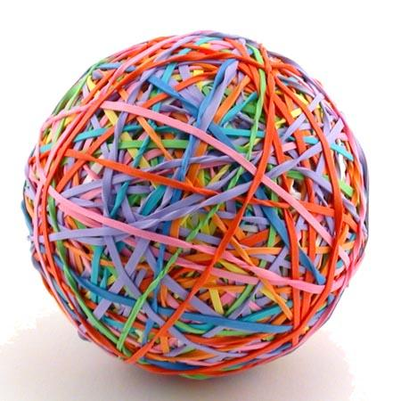
Pass the Ball Game
Pass the ball. When the music stops you must describe the picture!

Slide 2
Pass the BALL!
Notes:
2
Find the conversation question sheets (on many topics!) by clicking the Pass the Paper picture!

Slide 3
What is it?
Notes:
3

Slide 4
Pass the BALL!

Slide 5
What is it?

Slide 6
Pass the BALL!

Slide 7
What is it?

Slide 8
Pass the BALL!

Slide 9
What is it?

Slide 10
Pass the BALL!

Slide 11
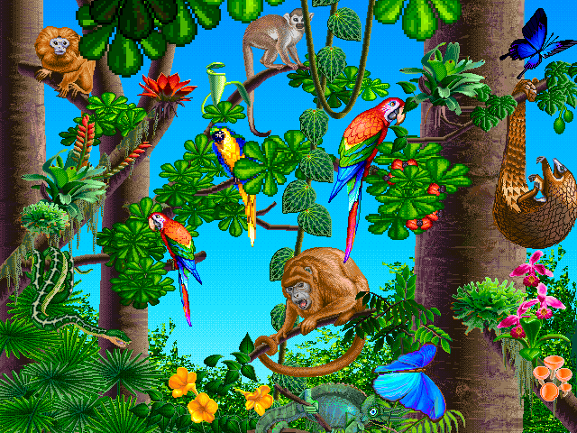
What is it?

Slide 12
Pass the BALL!

Slide 13
What is it?

Slide 14
Pass the BALL!

Slide 15
What is it?

Slide 16
Pass the BALL!

Slide 17
What is it?

Slide 18
Pass the BALL!

Slide 19
What is it?

Slide 20
Pass the BALL!

Slide 21
What is it?

Slide 22
Pass the BALL!

Slide 23
What is it?

Slide 24
Pass the BALL!

Slide 25
What is it?

Slide 26
Pass the BALL!

Slide 27
What is it?

Slide 28
Pass the BALL!

Slide 29
What is it?

Slide 30
Pass the BALL!

Slide 31
What is it?

Slide 32
Pass the BALL!

Slide 33
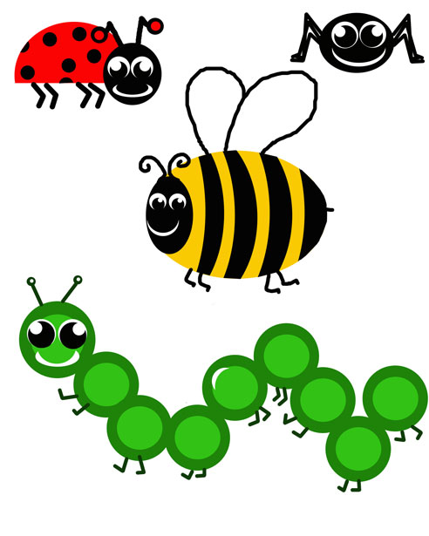
What is it?

Slide 34
Pass the BALL!
Notes:
34

Slide 35
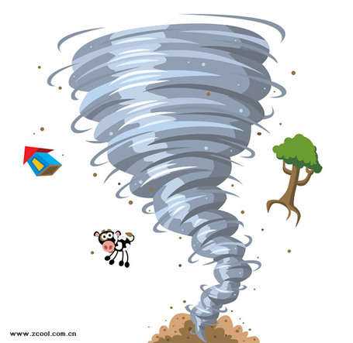
What is it?

Slide 36
Pass the BALL!
Notes:
36

Slide 37
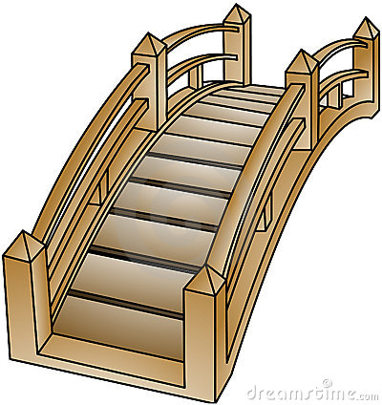
What is it?
.

Slide 38
Pass the BALL!

Slide 39
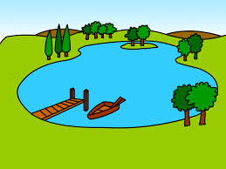
What is it?

Slide 40
Pass the BALL!

Slide 41
What is it?

Slide 42
Pass the BALL!

Slide 43
What is it?

Slide 44
Pass the BALL!
Notes:
44

Slide 45
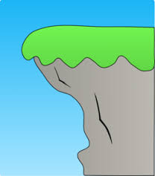
What is it?
Notes:
45

